Slide 1

Introduction to pySBOL (Python) & libSBOL (C++) Bryan Bartley bartleyba@sbolstandard.org Raytheon-BBN Technologies Cambridge, MA

Slide 2
Features in v2.3.0
Read and write SBOL files
Interface with online validation tool
Interface with SynBioHub repository
Parts-based design
Hierarchical sequence assembly
Workflow management and design-build-test-learn
Extensible data model and custom annotations
Support for combinatorial libraries
Biosystem design (modules & interactions)

Slide 3
PySBOL Installation
PySBOL packages available in Python 2.7 and 3.6 on Windows, Mac OSX, and Linux
Installation:
$ pip install pysbol --user
Documentation:
https://pysbol2.readthedocs.io/en/latest/
Repository:
https://github.com/SynBioDex/pySBOL

Slide 4
Python Code is Generated from C++
Code generation
with SWIG
Compilation
Extra plumbing
libSBOL
(.cpp)
Wrapper code
(.cxx)
Python extension library (.so, .dll)
pySBOL module
(.py)
LibSBOL can be translated into other languages implemented in C/C++ as well (eg, Matlab)
Some consistency of the API across different languages
Serialization is well-validated and predictable (ideal for a standard language such as SBOL!)

Slide 5
Guiding Philosophy
User-experience: An object-oriented approach to synthetic biology
Library implementation and specification diagrams are intuitively correlated
Extensible data model

Slide 6
User Experience

Slide 7
Object-oriented Synthetic Biology

Slide 8
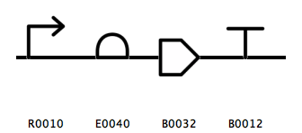
High-level Design Automation
Assemble hierarchies of parts
Compile DNA sequences from different parts; replace cut-and-paste
Assemble modules, eg, layered, regulatory gates and other modular systems
gene_example
Notes:
Why use SBOL not genbank?
Assemble template design first
Template designs specify general function using SO type not sequences
- Researcher might want a template and then instantiate different variants of the design
Researcher might not want to disclose information
Researcher might simply want a visual diagram of a circuit’s function

Slide 9
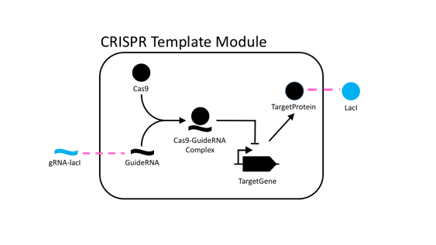
Other High-level Design Tasks
Connecting Module Inputs and Outputs
Mechanistic Modeling of Biochemical Interactions
Overriding Components in a Template Design

Slide 10
Library Implementation and Specification Document are Closely Correlated

Slide 11
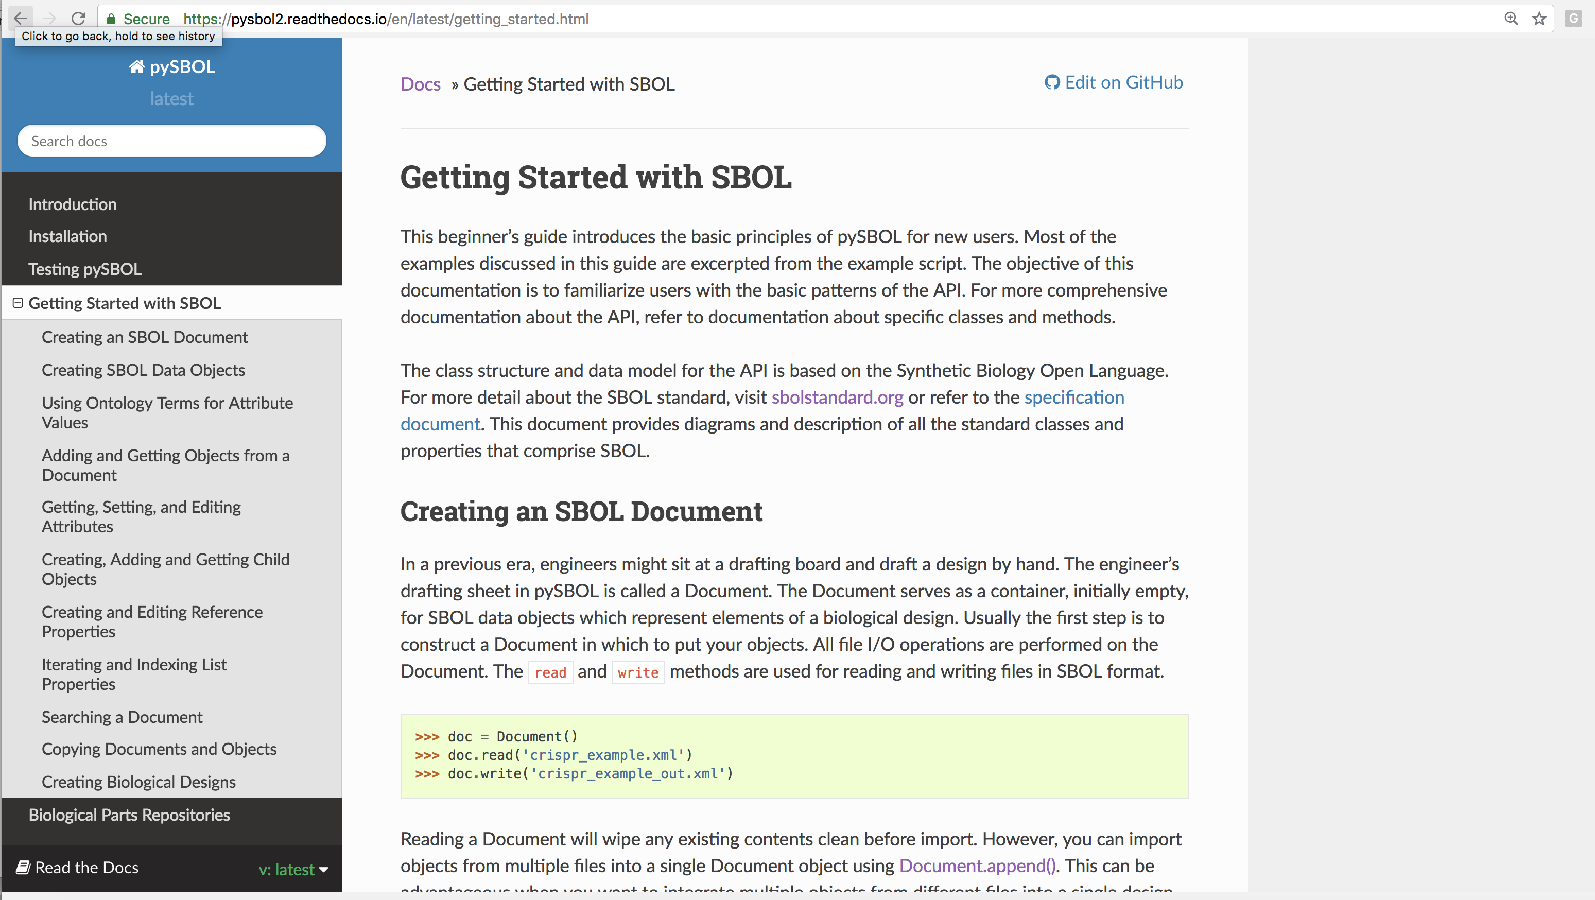
See Getting Started with SBOL http://synbiodex.github.io/libSBOL/getting_started.html
The examples in the online documentation is the first point of entry for understanding the Python API

Slide 12
SBOL Integrates Data Across the Semantic Web
Every SBOL data object has a uniform resource identifier (URI).

Slide 13
Every SBOL Objects has a Uniform Resource Identifier (URI).
“Compliant” URIs
http://sys-bio.org/my_design/1
scheme
namespace
displayId
version
Typed URIs
http://sys-bio.org/SBOLClass/my_design/1
scheme
namespace
type
displayId
version

Slide 14
An Example Constructor
Sets default namespace for URI generation
>>> setHomespace('http://sys-bio.org')
>>> cd0 = ComponentDefinition('cd0’, BIOPAX_DNA)
>>> print cd0
http://sys-bio.org/ComponentDefinition/cd0/1

Slide 15
An Example Constructor
Every constructor takes an identifier as its first argument
>>> setHomespace('http://sys-bio.org')
>>> cd0 = ComponentDefinition('cd0’, BIOPAX_DNA)
>>> print cd0
http://sys-bio.org/ComponentDefinition/cd0/1

Slide 16
An Example Constructor
>>> setHomespace('http://sys-bio.org')
>>> cd0 = ComponentDefinition('cd0’, BIOPAX_DNA)
>>> print cd0
http://sys-bio.org/ComponentDefinition/cd0/1
Note the full URI is constructed from the user specified ID

Slide 17
An Example Constructor
>>> setHomespace('http://sys-bio.org')
>>> cd0 = ComponentDefinition('cd0’, BIOPAX_DNA)
>>> print cd0
http://sys-bio.org/ComponentDefinition/cd0/1
>>> cd0.roles = [ SO_PROMOTER ]
Optional fields can be set after an object is constructed

Slide 18
The official specification documentation is the second point of entry for understanding the Python API

Slide 19
Cardinality dictates if property values are returned as a list versus a singleton value
Note: some properties are initialized with a default value
>>> from sbol import *
>>> cd0 = ComponentDefinition('cd0')
>>> print(cd0.types)
['http://www.biopax.org/release/biopax-level3.owl#DnaRegion']
>>> print(cd0.roles)
[]

Slide 20
An open diamond indicates the property contains URI(s)
>>> cd0.sequences = Sequence('cd0')
>>> cd0.sequences
['http://examples.org/Sequence/cd0/1']

Slide 21
A closed diamond indicates object ownership (i.e., composition)
>>> cd0 = ComponentDefinition('cd0')
>>> sa = cd0.sequenceAnnotations.create('sa')

Slide 22
Compositional properties behave somewhat like Python dictionaries
>>> cd0.sequenceAnnotations['sa'] = SequenceAnnotation('sa') # same as create method
>>> cd0.sequenceAnnotations['sa']
SequenceAnnotation
>>> cd0.sequenceAnnotations['sa'].identity
'http://examples.org/ComponentDefinition/cd0/sa/1'

Slide 23
The pySBOL API includes shortcuts that are NOT specified by the data model.
For these cases, the examples in the pySBOL documentation are the best reference.
>>> cd.sequence = Sequence('seq')
>>> cd.sequences
['http://examples.org/Sequence/seq/1']

Slide 24
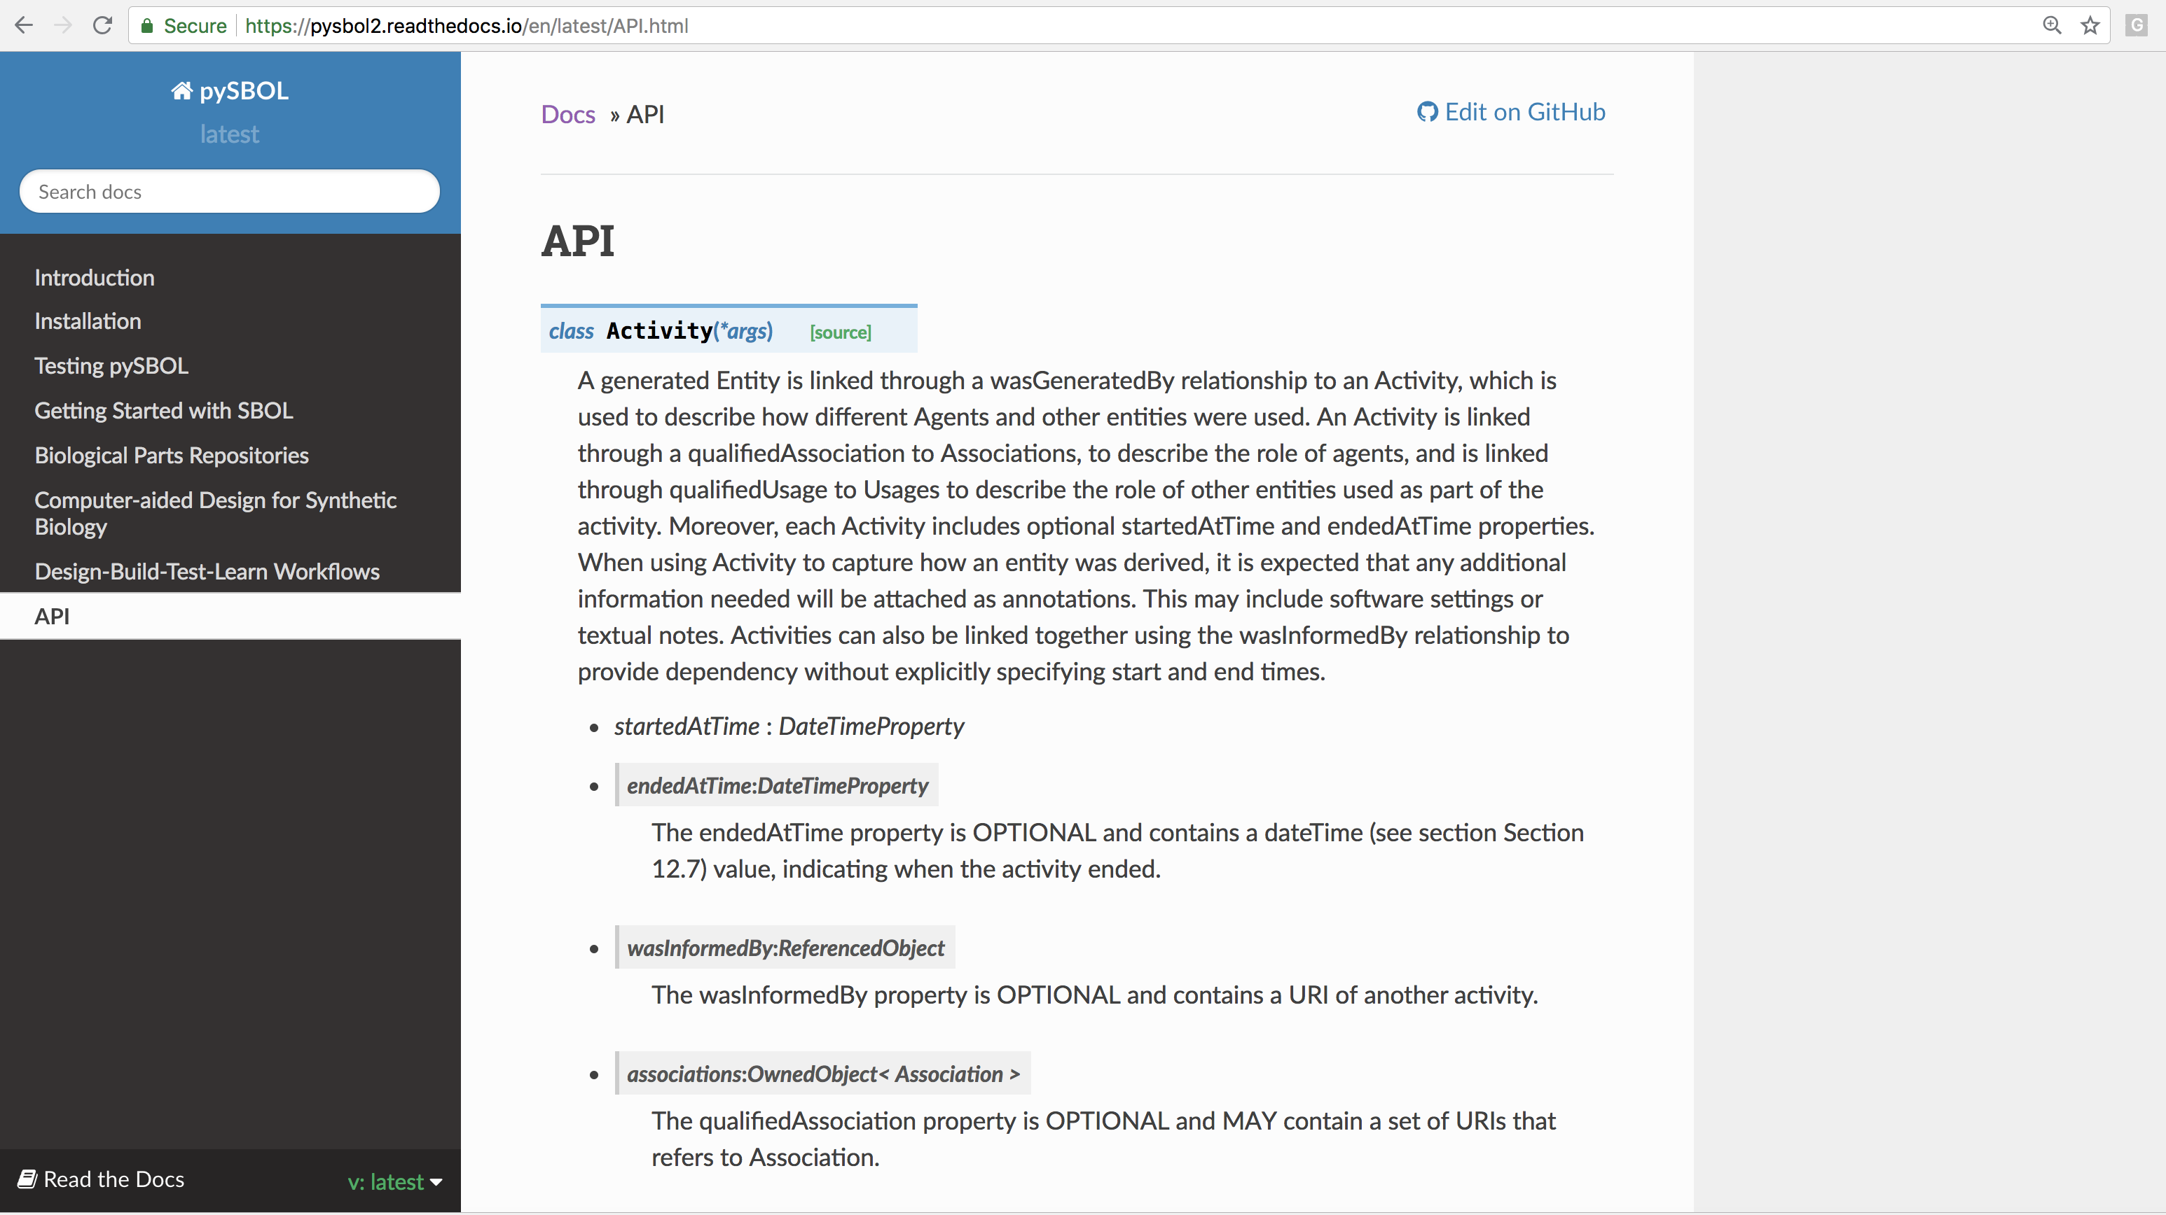
The pySBOL API auto-documentation is not great…

Slide 25
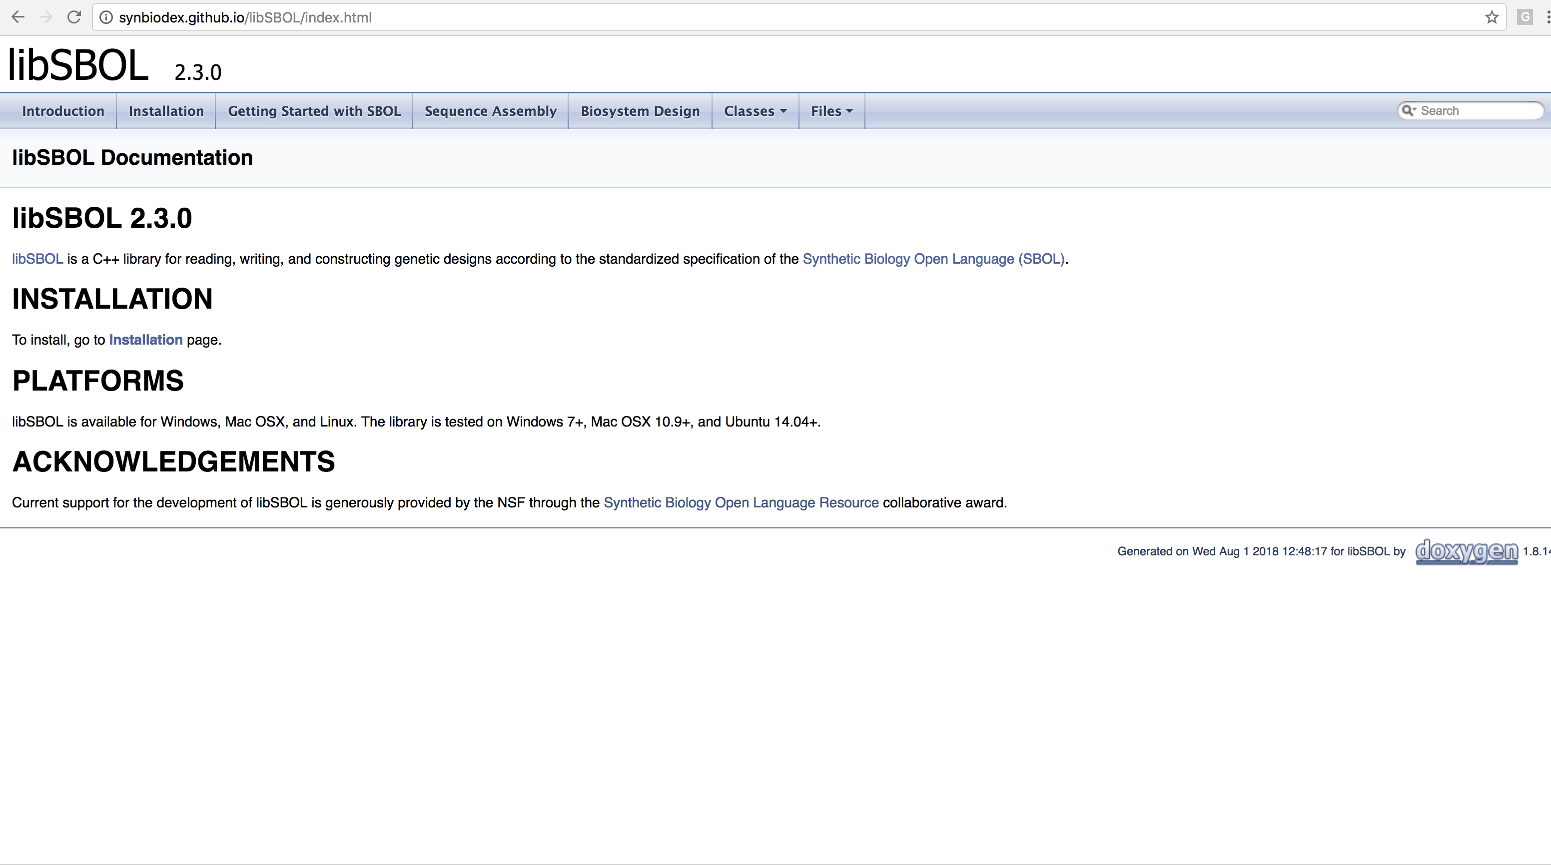
Refer back to the libSBOL API documentation for clarification

Slide 26
DBTL Workflows

Slide 27
SBOL Leverages the Provenance Ontology (PROV-O)
Implement-
ation
Agent
wasGeneratedBy
Activity
Association
Legend
“build”
Workflow
SBOL Core
Plan
PROV-O
Module
Definition
Usage
Lebo T, Sahoo S, McGuinness D, Belhajjame K, Cheney J, Corsar D, Garijo D, Soiland-Reyes S, Zednik S, Zhao J. Prov-o: The prov ontology. W3C recommendation. 2013 Apr 30;30.

Slide 28
transformed_cells = build_workflow_step.generateBuild('transformed_cells', design)
The pySBOL API provides helper classes to simplify understanding of SBOL’s provenance rules.
These classes are used in today’s tutorial.

Slide 29
Use Cases
design target sequence
D
PCR amplification
B
B
2-way Gibson assembly
Design Activity
B
transformed_cells = build_workflow_step.generateBuild
(list_of_cell_ids, None, gibson_mix)
Build Activity
Transform E. coli
Test Activity
Learn Activity
B
B
B
B
B
Perform sequencing reactions
Characterize
in plate reader
T
T
T
T
Fit an ODE model
Create a data sheet
A
A

Slide 30
“In-house” Workflow Systems Can be Integrated with SBOL
SBOL is an “extensible standard”
SBOL libraries provide annotation and extension mechanisms
Existing, “in-house” workflow systems can be linked to SBOL using these mechanisms

Slide 31
Extensibility

Slide 32
Custom Annotation Data
>>> cd = ComponentDefinition('cd0')
>>> annotation = TextProperty(cd, 'http://sys-bio.org#annotationProperty', '0', '1')
>>> annotation.set('This is a test property')
>>> annotation.get()
'This is a test property'
<?xml version="1.0" encoding="utf-8"?>
<rdf:RDF xmlns:dcterms="http://purl.org/dc/terms/"
xmlns:prov="http://www.w3.org/ns/prov#"
xmlns:rdf="http://www.w3.org/1999/02/22-rdf-syntax-ns#"
xmlns:sbol="http://sbols.org/v2#"
xmlns:sys-bio="http://sys-bio.org#">
<sbol:ComponentDefinition rdf:about="http://examples.org/ComponentDefinition/cd0/1">
<sbol:displayId>cd0</sbol:displayId>
<sbol:persistentIdentity rdf:resource="http://examples.org/ComponentDefinition/cd0"/>
<sbol:type rdf:resource="http://www.biopax.org/release/biopax-level3.owl#DnaRegion"/>
<sbol:version>1</sbol:version>
<sys-bio:annotationProperty>This is a test property</sys-bio:annotationProperty>
</sbol:ComponentDefinition>
</rdf:RDF>

Slide 33
Extension Classes
DPL_NS = 'http://dnaplotlib.org#'
class ModuleDefinitionExtension(ModuleDefinition):
def __init__(self, id = 'example'):
ModuleDefinition.__init__(self, id)
self.x_coordinate = TextProperty(self, DPL_NS + 'xCoordinate, '0', '1', '10')
self.y_coordinate = IntProperty(self, DPL_NS + 'yCoordinate', '0', '1', 10)
doc = Document()
doc.addNamespace('http://dnaplotlib.org#', 'dnaplotlib')
md = ModuleDefinitionExtension('md_example')
print (md.x_coordinate)
md.y_coordinate = 5
print (md.y_coordinate)

Slide 34
1
Data exchange with pySBOL extension classes
Host(ModuleDefinition)
.py
.py
Host(ModuleDefinition)
<host_context:Host>
Python
.sbol
C++/Java
Data exchange with generic annotations
2
Host(ModuleDefinition)
GenericTopLevel()
.py
<host_context:Host>
Python
.sbol
C++/Java

Slide 35
Concluding Remarks

Slide 36
Acknowledgements
Kiri Choi
PhD Student
UW
Anil Wipat and the Newcastle team
Chris Myers and the Utah team
The SBOL Editors
NSF award #1355909
Kyle Medley
PhD Student
UW
Herbert Sauro,
Associate Professor of Bioengineering
UW

Slide 37

Please try out!

